Slide 1
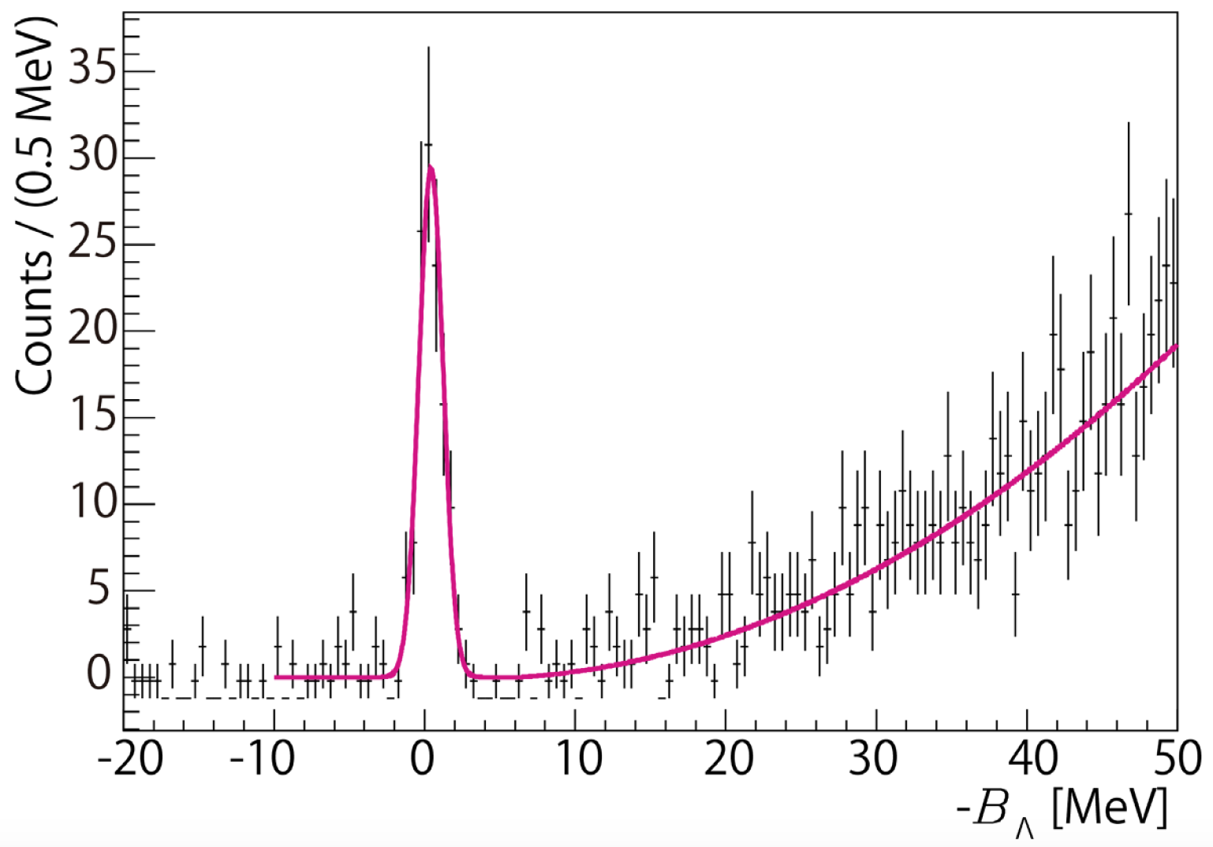
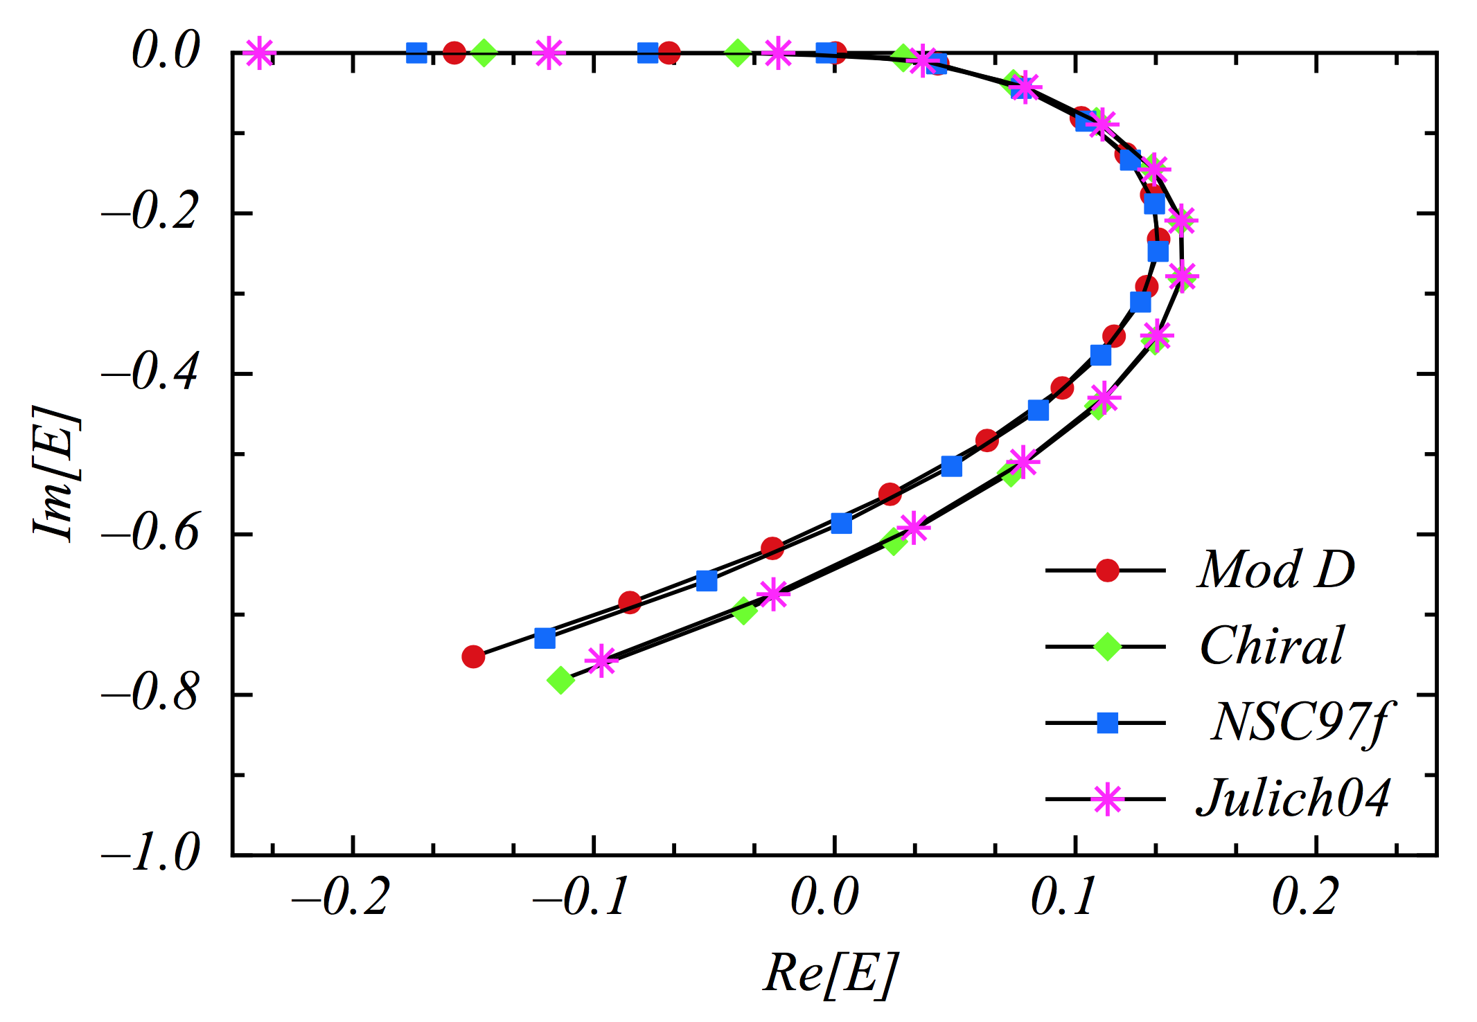
Determining the Unknown Λn Interaction by Investigating the Λnn Resonance
PAC 45 proposal: PR12-17-003
L. Tang
Hampton University / JLAB
On behalf of Hall A collaboration
Hall A/C Collaboration Meeting, JLAB, June 23, 2017

Slide 2
INTRODUCTION
Understanding the bayronic interaction with all flavors is one of the essential goals of nuclear physics – Many-body system bound by the strong interaction.
For NN interaction, there are plenty of scattering data, while for the YN and YY interactions scattering data are extremely limited or none. Here we focus on ΛN interaction.
Experimental data from hypernuclei made significant contribution in acquiring indirect or supplemental information on ΛN interacts, such as the high precision spectroscopy obtained from the JLab hypernuclear experiments.
However, the standing puzzles (such as Charge-Symmetry-Breaking and “Hyperon Puzzle” on neutron star’s mass) are better resolved by direct ΛN interaction data.

Slide 3
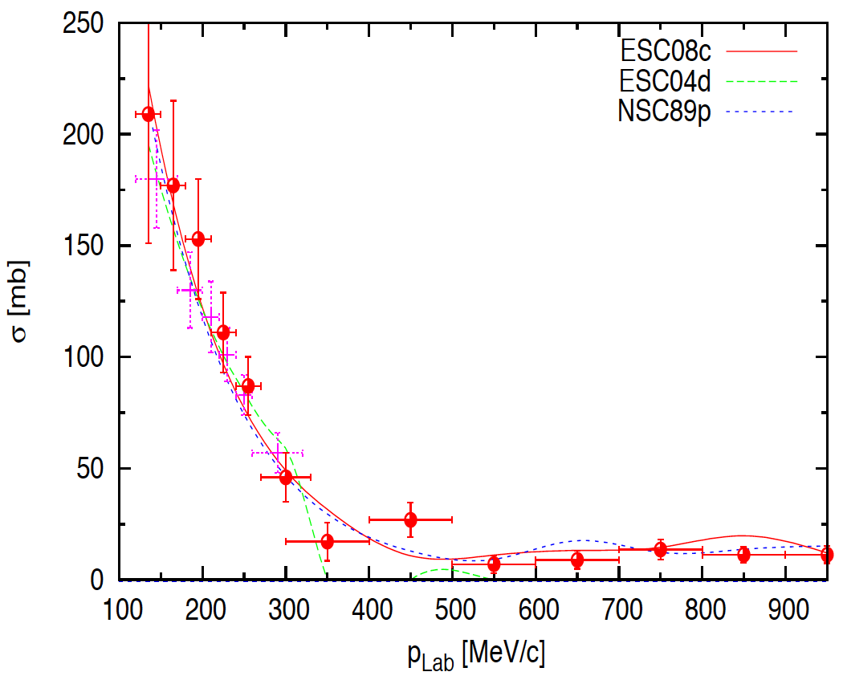
UNDERSTANDING OF B-B INTERACTION
APPROACH: Combined analysis with input from NN, YN, YY scattering data, nuclear and hypernuclear data on BE and U_{Y}, plus hadron physics (Experiments and Theory on flavors, quarks, QCD dynamics)
N-N Scattering
~ 4300 events
+ low energy part
This made NN interaction much better understood
Λ-p Scattering
< 100 events
Uncertainty >20% at low energy
(Need further improve)
Λ-n Scattering
None!
Based on the NN interaction, the Λn interaction is treated to have the same property as that of Λp interaction

Slide 4
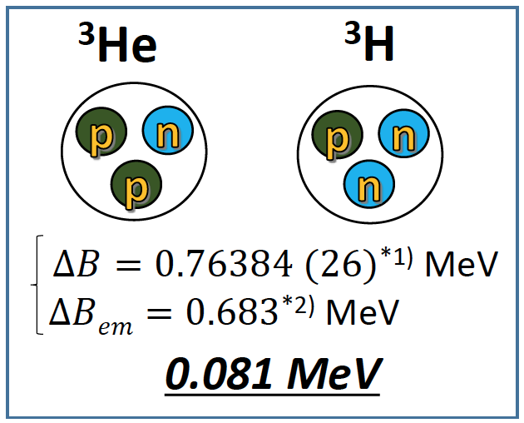
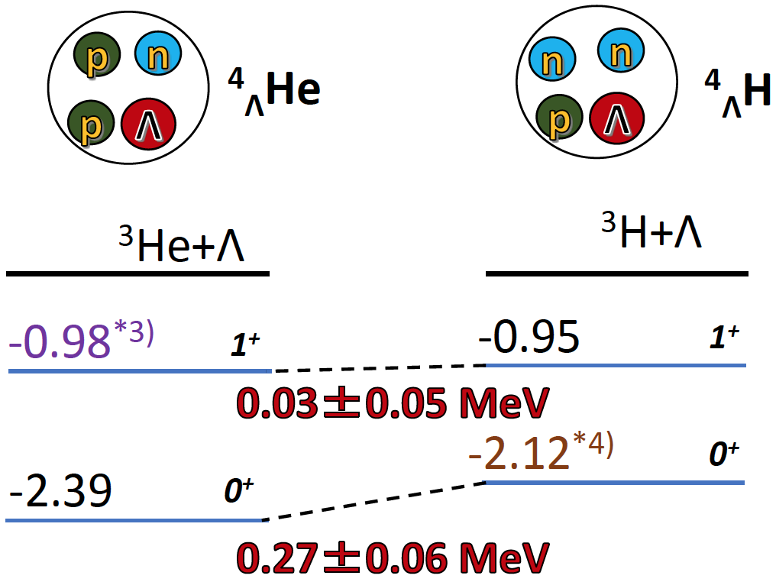
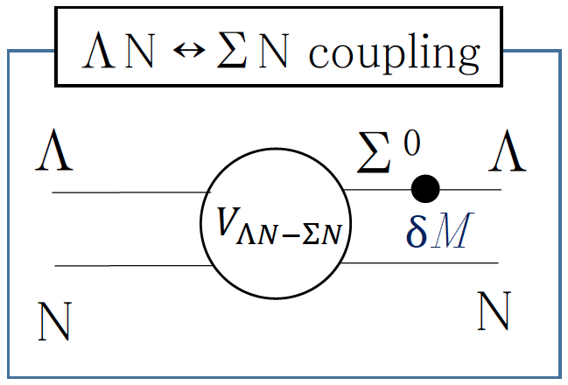
CHARGE SYMMETRY BREAKING (CSB)
N-N Interaction
Λ-N Interaction
-
-
*1) J.H.E. Mattauch et al., Nucl. Phys. 67, 1 (1965).
*2) R.A. Brandenburg et al., NPA 294, 305 (1978).
*3) T.O. Yamamoto et al., Phys. Rev. Lett. 115, 222501 (2015).
*4) A. Esser et al., Phys. Rev. Lett. 114 232501 (2015).
This leads to:
Good approximation w/o CSB.
Common for B-B interactions,
i.e. Λp and Λn interactions are
treated basically identical.
D. Gazda, A. Gal, Nucl. Phys. A 954, 161 (2016).
A. Gal, Phys. Lett. B 744 352 (2015).
Experimental data of Λn interaction becomes extremely valuable

Slide 5
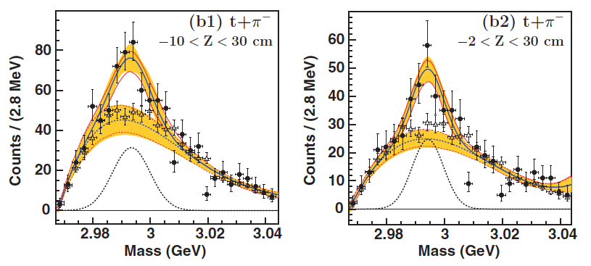
DISCOVERY OF A Λnn SYSTEM
⁶Li (2A GeV) on ¹²C target and study the invariant mass of final state particles
JJ
JJ
C. Rappold et al., Phys. Rev. C 88, 041001(R) (2013)
It was claimed to a bound state.
All theoretical analyses applying the current YN interaction modes ruled it out.
Question 1: Can it be a physical resonance?
Question 2: If it is a resonance, can it provide us for the first time the
experimental information about Λn interaction?

Slide 6
THEORY INVESTIGATION ON Λnn RESONANCE
Iraj R. Afnan and Benjamin F. Gibson, Phys. Rev. C 92, 054608 (2015)
Pairwise interactions of rank one, i.e. separated potentials for nn and Λn interactions.
Four different baryonic potential models were used to fit for the effective range parameters of the nn and Λp interactions from the existing scattering data.
Solving the Λnn Faddeev equations into the second complex energy (E) plane and examining the eigenvalue.
Assume Λn and Λp interactions are the same to begin. Continuously scaling up Λn strength, 2.5% per step, to obtain an eigenvalue spectrum.
A Λnn 3-body system
>25%
(Bound)
Real
resonance
(MeV)
Start
5%
Sub-threshold
resonance
(MeV)
The observed Λnn system is likely to be pure T=1 3-body resonance
By measuring the BE and Width of the resonance peak, the Λn interaction strength relative to Λp interaction can be determined for the first time by an experimental data.

Slide 7
A UNIQUE EXPERIMENT ONLY AT JLAB
Production: ³H(e, e’K⁺)(Λnn) reaction.
A T₂ target will be available for the 4 already approved experiments: (Hall A: E12-10-103, E12-11-112, E12-14-109, and E12-14-011)
E12-14-011 is a coincidence experiment with ³H(e, e’p) reaction. Using the same beam energy, just changing the particle ID and kinematics, it can be converted into a ³H(e, e’K⁺)(Λnn) experiment.
With good CEBAF beam quality, excellent HRS resolution, and the available H₂ target for Λ and Σ⁰ production, Δ(BE) < 0.1 MeV and energy resolution can be < 2.0 MeV FWHM.
The opportunity is unique and not possible elsewhere.
Kinematics configuration (q = 400 MeV/c)
Beam energy (2-passes, 2.2 GeV per pass) | 4.524 GeV
e’ HRS central momentum (acceptance) | 2.45 GeV/c (±4.5%)
e’ HRS central angle (acceptance) | 12.5° (6 msr)
K⁺ HRS central momentum (acceptance) | 1.8 GeV/c (±4.5%)
K⁺ HRS central angle (acceptance) | 14.0° (6 msr)

Slide 8
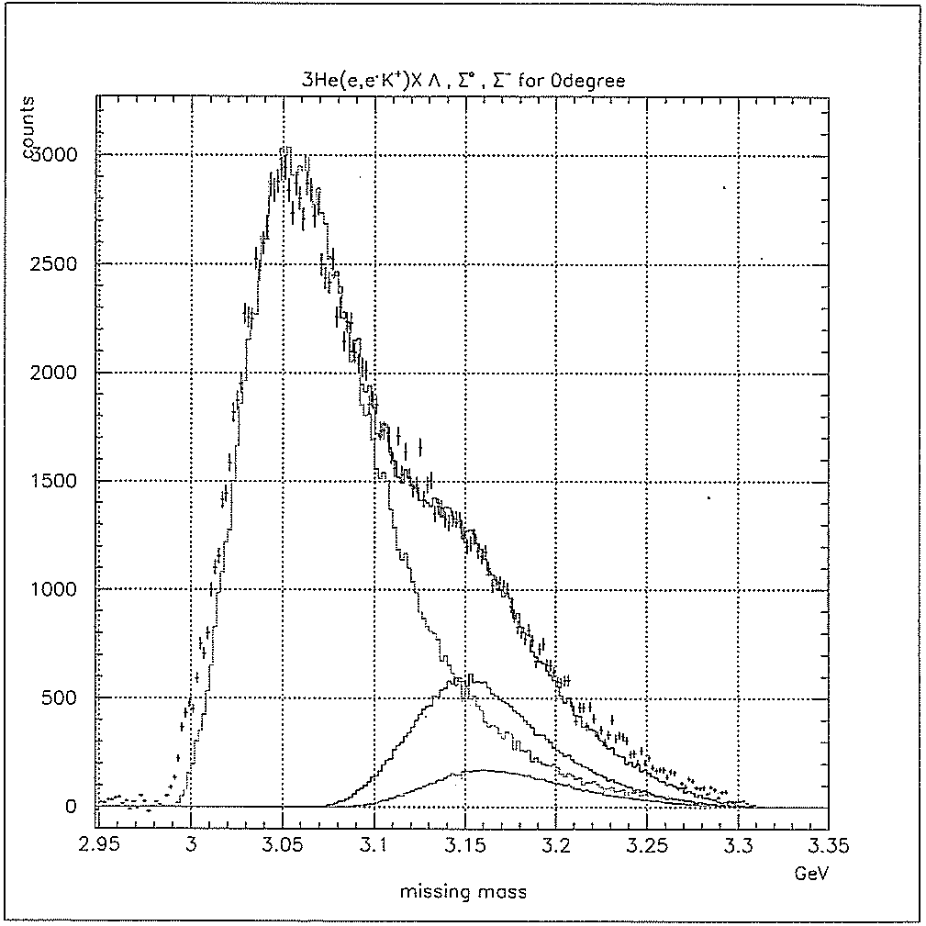
HALL C E91-016: PROVIDED KNOWN INFOMATION
³He(e,e’K⁺) Reaction
Q² and q to Λ are identical to the proposed experiment.
T = 1 Λpn and Λnn systems are identical.
T₂ target: Λ and Σ⁰ productions are reduced by 2 while Σ⁻ increases by 2.
Λnn resonance is expected to locate within ~1 MeV above threshold, no quasi-free distribution influence.
The known information from E91-016 helped to a reliable estimate on yield, singles rate, and ACC rate.
Λd, T = 0 and 1
Λpn, T = 1
Λ
Σ⁰
Σ⁻
Missing Mass (GeV)
A. Uzzle, Ph.D. dissertation and F. Dohrmann et al., PRL 93, 242501 (2004).
Expected Resonance Yield Rate
Ratio of FSI events over the entire Λ production: ≥ 3% (excluding Σ⁰ and Σ⁻).
The entire FSI should be pulled into the expected resonance.
Taking 3% as the minimum, 60 counts from 5 PAC days are expected.

Slide 9
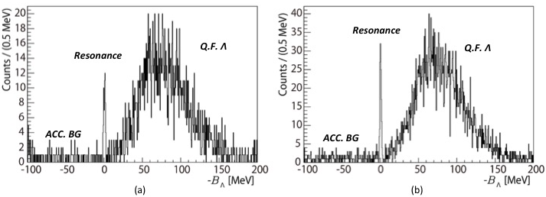
EXPECTED RESULT - SIMULATIONS
5 PAC days: ~ 60 counts
10 PAC days: ~ 120 counts
Assumptions: Gaussian peak @ B_{Λ} = 0.5 MeV, Γ = 0.5 MeV, energy resolution 2 MeV FWHM
With 5 PAC days of data acquisition, a peak should be observed - Minimum
With 10 PAC days, a solid determination on B_{Λ} and Γ can be achievement.

Slide 10
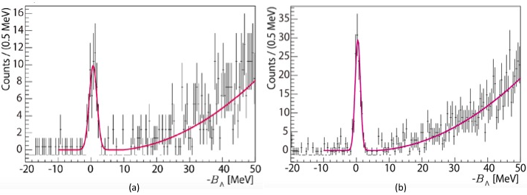
UNCERTAINTIES – SIMULATIONS
5 PAC days: ~ 60 counts
10 PAC days: ~ 120 counts
Statistics vs Uncertainty | δB_{Λ} | δΓ
5 PAC days (60 counts) | ± 0.18 MeV | ± 0.20 MeV
10 PAC days (120 counts) | ± 0.09 MeV | ± 0.07 MeV

Slide 11
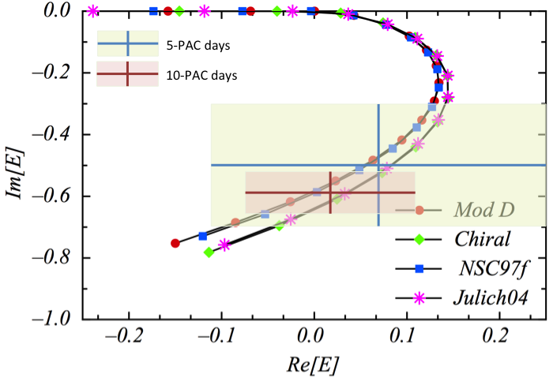
UNCERTAINTY VS IMPACT
Uncertainty size is NOT for judging the correctness of baryonic models.
It marks a REGION that determines the strength and low energy property of Λn interaction.
Further significant reduction comes from improving Energy Resolution.

Slide 12
BEAM REQUEST
Minimum impact | T₂ run (Λnn spectroscopy) H₂ run (Calibration with Λ and Σ⁰ | 5 PAC days 2 PAC days
Maximum impact | T₂ run (Λnn spectroscopy) H₂ run (Calibration with Λ and Σ⁰ | 10 PAC days 2 PAC days
SUMMARY
Λnn resonance is a unique tool to determine the Λn interaction.
A JLab experiment using the (e,e’K⁺) reaction is the only possible one for an experimental determination of Λn interaction for the first time.
T₂ target will be available for the already approved 4 experiments. This proposed experiment needs no additional equipment.
The result may be the only experimental source to determine the Λn interaction for long time.

